Slide 1
GLASSES DETECTION SYSTEM
DEEP LEARNING PROJECT

Slide 2
ABSTRACT
Face recognition is a fascinating application in the field of image recognition. However face images with glasses create hindrance. Glasses detection plays an important role in face recognition and soft biometrics for person identification. However, automatic glasses detection is still a challenging problem under real application scenarios because of face variations, light conditions, and self-occlusion, have significant influence on its performance.
The goal of this project is to classify images of people into two classes: Glass and No-Glass based upon whether they wear a glass in the image or not. However, there is a variety in the shape, design and appearance of glasses which makes it challenging.

Slide 3
PROBLEM STATEMENT
Biometrics and biometric recognition are areas of research, which become more and more important. The use of biometrics is an approach to get solutions for unresolved problems in surveillance, person identification and verification, because the technological innovation allows to perform measuring and processing of biometrical data fast and trusty.
A lot of research does not only concentrate on one single characteristic, it heads for combinations of biometric tokens. Glasses detection is a cardinal component in facial/ocular analysis that powers forensic, surveillance and biometric authentication systems.

Slide 4
OBJECTIVE
In this work we are concerned with the face recognition and face analysis token and we focus on eyeglasses detection and segmentation as a pre-processing step for face recognition and analysis applications.
For robust face recognition it is essential to have normalised pictures. Normalised face images should be interference-free and should contain a frontal pose, neutral expression and ’normal’ eyeglasses with a typical frame, clear glasses and no reflections. Therefore it is necessary to detect eyeglasses and - if present - to delineate and evaluate the eyeglasses. This leads to solving problems in the areas of classification and segmentation .
Normalised images which come up with all the necessary qualifications increase the reliability of face recognition and detection software.

Slide 5
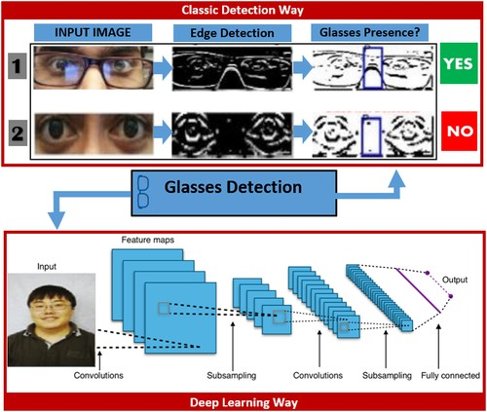

Slide 6
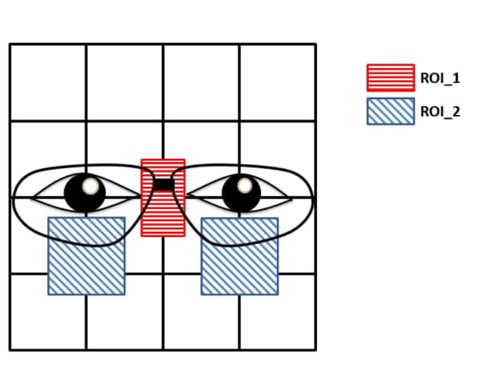
METHOD
To determine the presence of glasses, the edgeness value (y-direction) of two important regions of the aligned face are computed. Then a indicator is constructed based on these values to do the classification
The two measurement regions are shown on the schematic below.

Slide 7
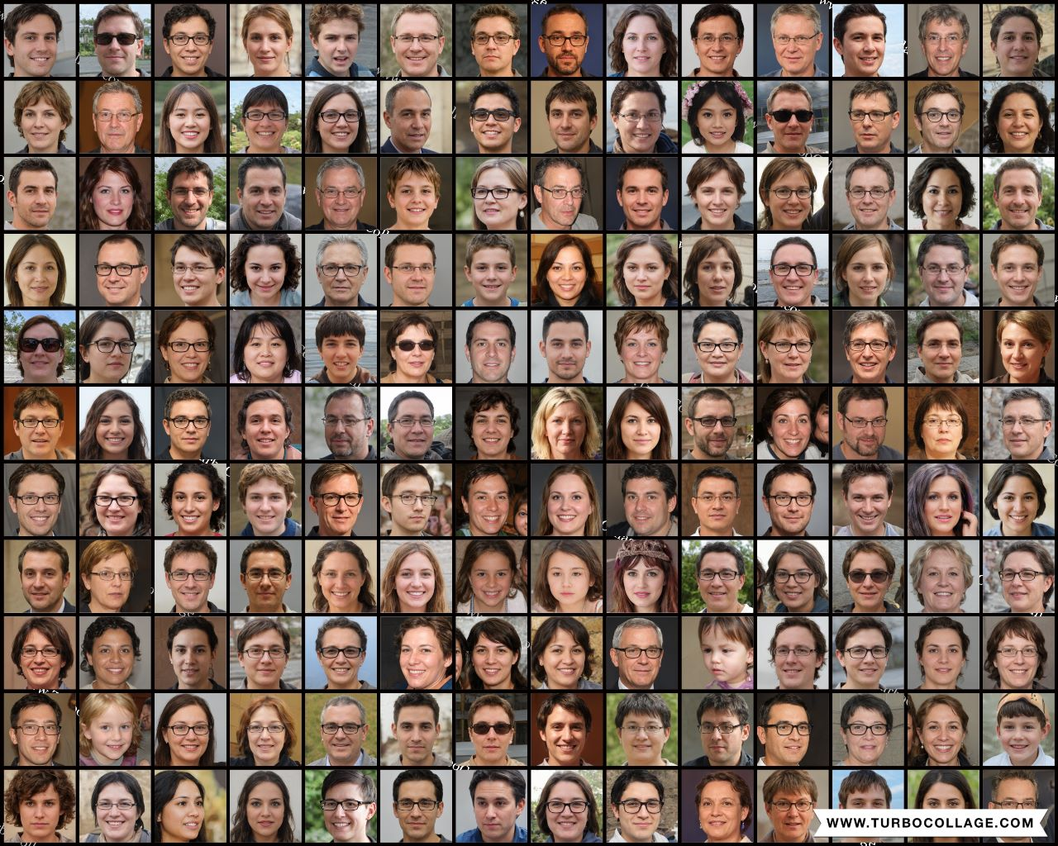
DATASET
5000 Facial Images

Slide 8
Step by Step Method
Data Collection
Understanding the data
Data Cleaning
Loading the dataset and preprocessing the dataset.
Splitting the dataset and increasing the size of training data by augmentation.
Using the proper Deep-learning model(architecture) to train the dataset.
Compiling and fitting the model.
Checking the accuracy of the model.

Slide 9
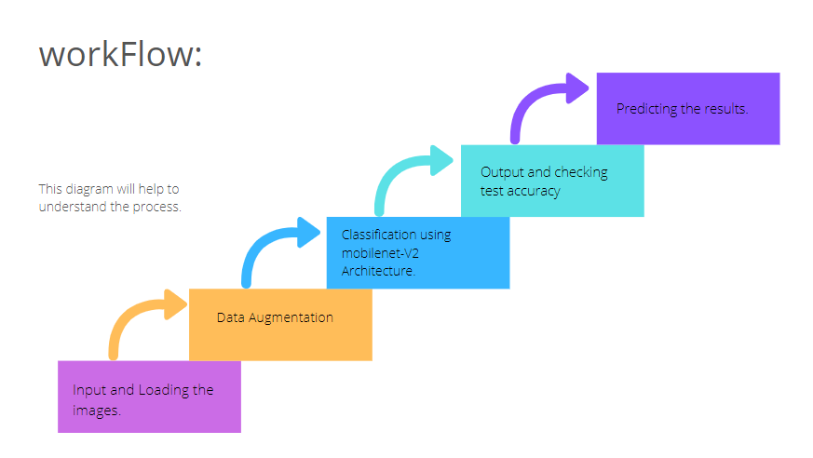
Flowchart to understand the process.

Slide 10
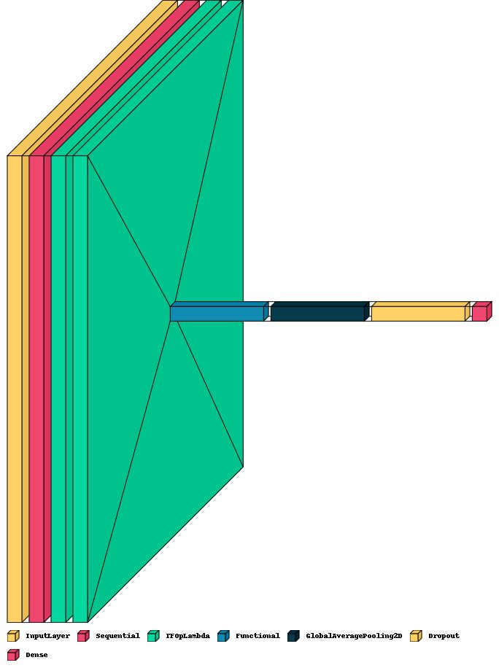
Proposed methodology : Diagrammatic representation.

Slide 11
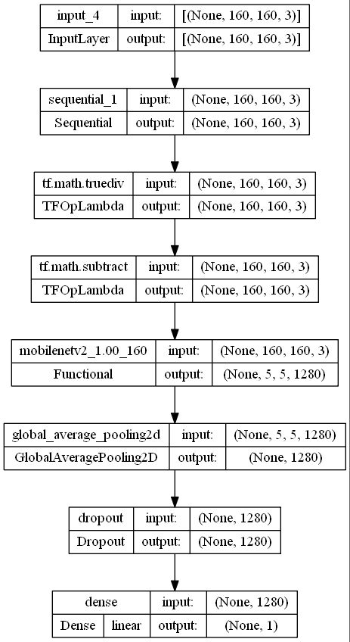
Summary of the model

Slide 12
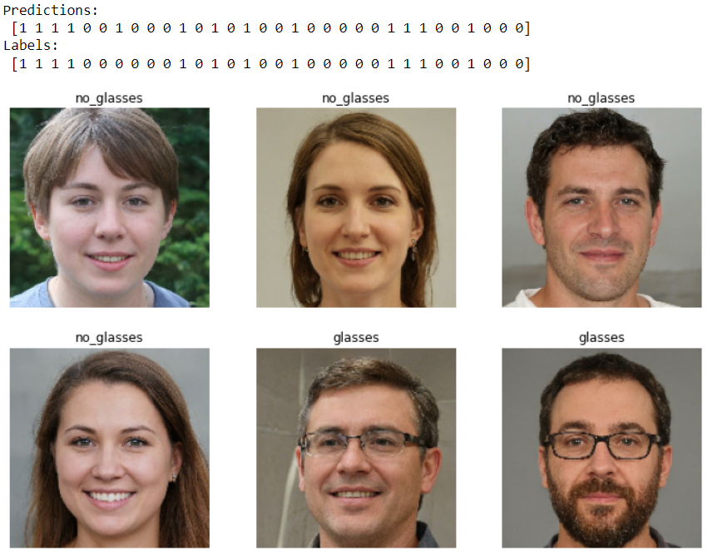
Predictions made by model on custom-images.

Slide 13

Github Proof
https://github.com/vq7484/Glasses-Detection-System-using-DL/upload

Slide 14
THANK YOU
V.KAUSHAL – RA2011047010038(Project Coding)
S.M.SUHAIL - RA2011047010041(Project Coding)
ESHWAR SAI - RA2011047010049(Dataset Collection and Coding)
CHAITANYA KOTA - RA2011047010052 (Dataset Collection and PPT)
NITIN DARAPAREDDY - RA2011047010075(GitHub and PPT)

